Slide 1



Red vs Blue Team
Capstone Engagement

Slide 2
Red Team vs Blue Team
Red Team Security
Network Topology
Recon
Vulnerability Assessment
Exploitation
Blue Team
Log Analysis
Mitigations
Proposed Alarms
Attack Characterisation
Mitigation Strategies

Slide 3
This document contains a summary of the critical security flaws discovered in the Red Team Security Assessment of Project 2 Red-vs-Blue Team. The vulnerabilities were identified on the network using penetration testing tools and manual security analysis techniques. The Common Weakness Enumeration (CWE) is an industry-standard classification of types of software weaknesses or flaws, that can lead to security problems. CWE™ is a community-developed list of software and hardware weakness types. It serves as a common language, a measuring stick for security tools, and as a baseline for weakness identification, mitigation, and prevention efforts. In the Blue Team Log Analysis and Attack Characterisation we utilise Kibana in Elastic Stack to analyse and illustrate the attack. Kibana enables the visual analysis of data from an Elasticsearch with Logstash and Beats. Using Kibana’s interface allows us to query data in Elasticsearch indices and then visualise the results through various chart options. The Blue Team proposes mitigations Strategies to create alarms and harden the system concerning the flaws discovered. The recommendations are not exhaustive.
Summary

Slide 4
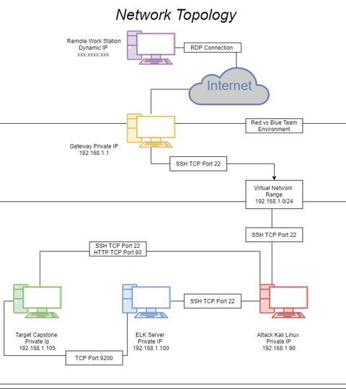

Network Topology
We mapped the network topology of the project, inclusive of the Kali Attacking Machine, ELK server and the Target Machine
RDP Connection from Remote Workstation to Gateway
Gateway Port 22 SSH Kali Linux
Kali Linux to Target SSH Port 22 & HTTP Port 80
ELK Server to Target TCP Port 9200

Slide 5
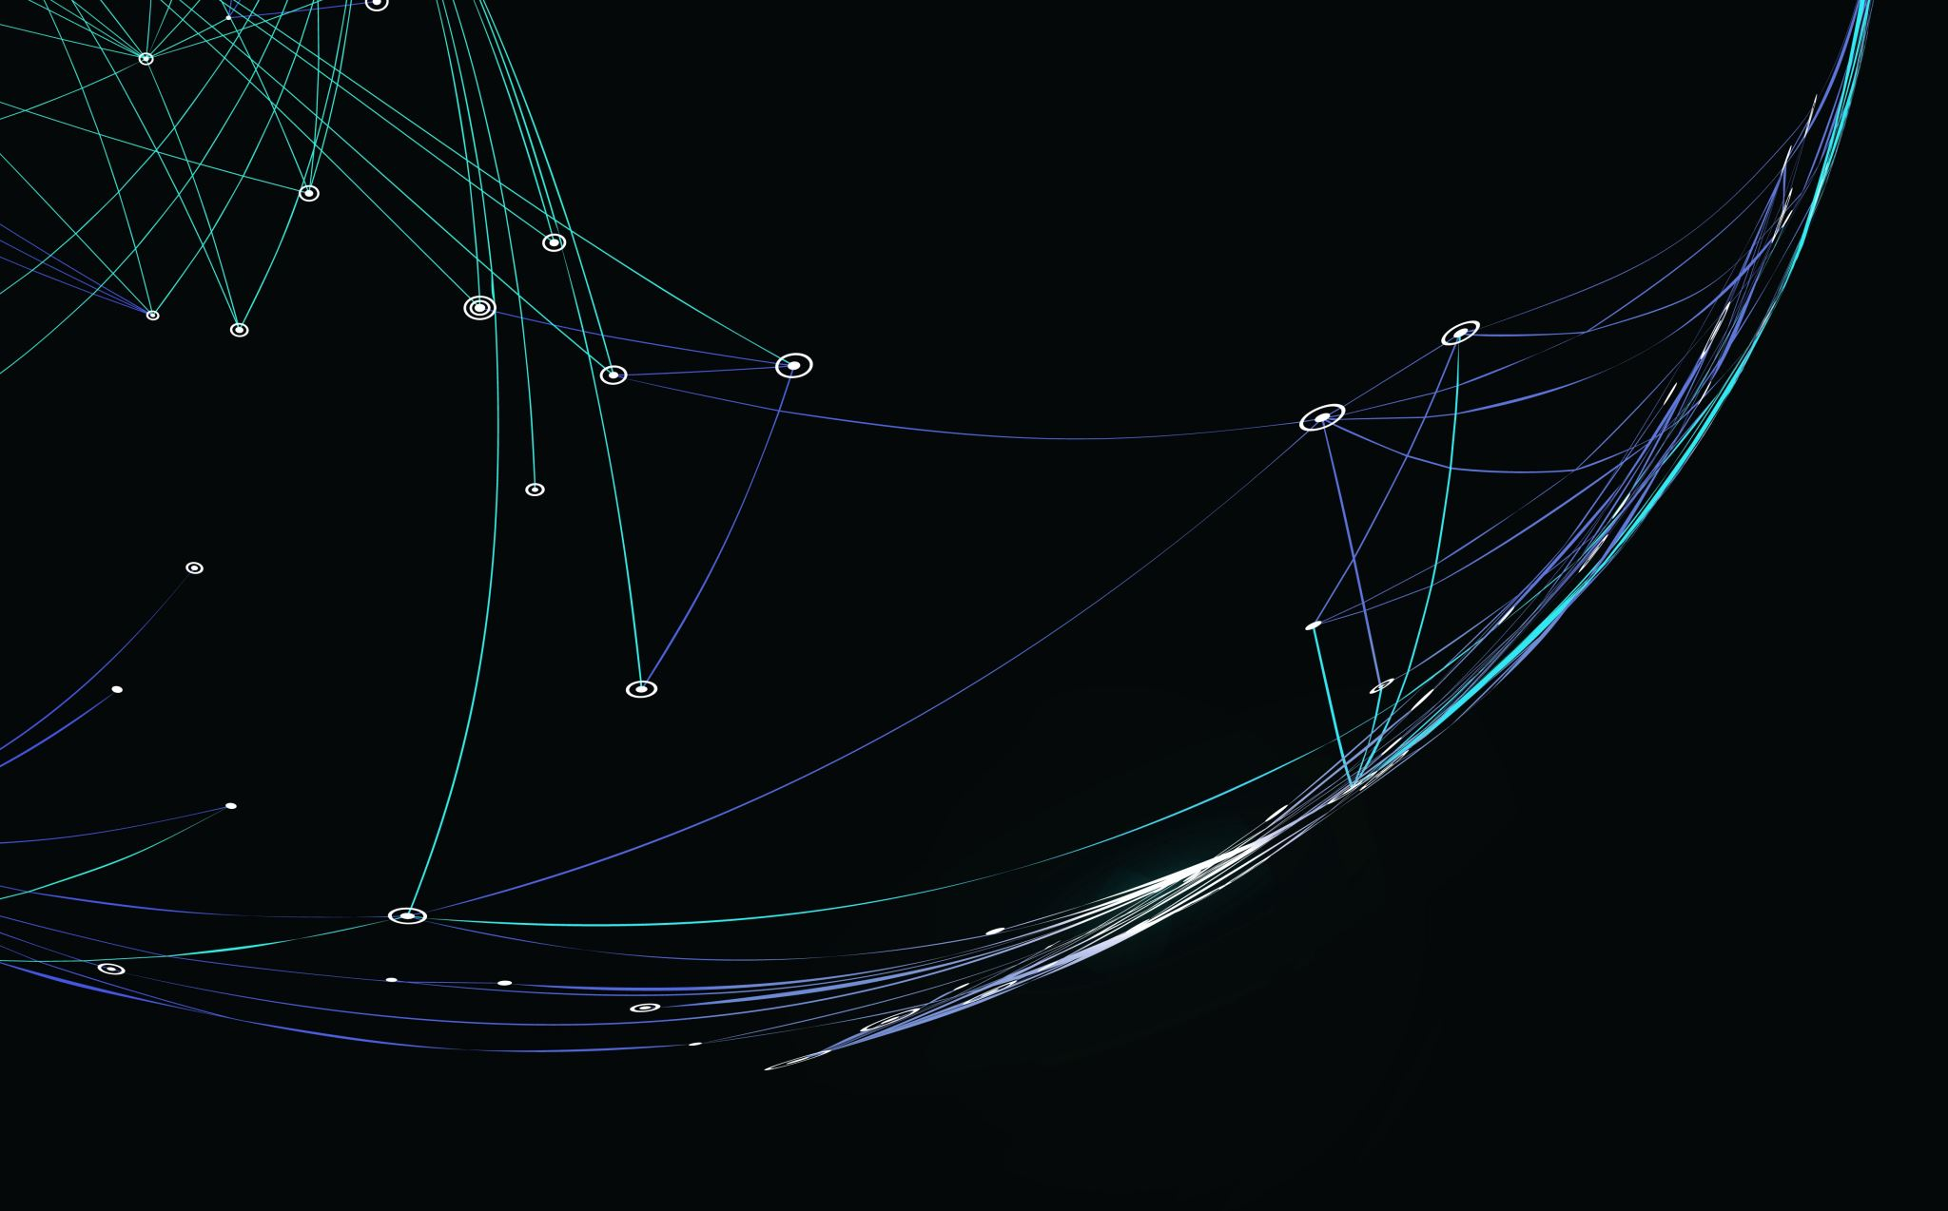
Red Team Security Assessment

Slide 6
Network Red Team vs Blue Team Subnet
IP Address Range
Subnet Mask
Gateway
192.168.1.0/24
255.255.255.0
192.168.1.1

Slide 7
Recon We used NMAP to scan the network, and identified the following hosts
Hostname
IP Address
Role on Network
Gateway
Kali Linux
ELK Server
Capstone
192.168.1.1
192.168.1.90
192.168.1.100
192.168.1.105
Hyper-V Host
Attack (Penetration Tester) Machine
Security Monitoring
Target (Vulnerable Web) Server

Slide 8
Vulnerability Improper Authorisation of Index Containing Sensitive Information
Vulnerability
Description
Impact
CRITICAL
CWE-612
The product creates a search index of private or sensitive documents, but it does not properly limit index access to actors who are authorized to see the original information
Web sites and other document repositories may apply an indexing routine against a group of private documents to facilitate search. If the index's results are available to parties who do not have access to the documents being indexed, then attackers could obtain portions of the documents by conducting targeted searches and reading the results. The risk is especially dangerous if search results include surrounding text that was not part of the search query. This issue can appear in search engines that are not configured (or implemented) to ignore critical files that should remain hidden; even without permissions to download these files directly, the remote user could read them

Slide 9
Vulnerability Exposure of Sensitive Information to an Unauthorised Actor
Vulnerability
Description
Impact
CRITICAL
CWE-200
The product exposes sensitive information to an actor that is not explicitly authorised to have access to that information
There are many different kinds of mistakes that introduce information exposures. The severity of the error can range widely, depending on the context in which the product operates, the type of sensitive information that is revealed, and the benefits it may provide to an attacker. Some kinds of sensitive information include: private, personal information, such as personal messages, financial data, health records, geographic location, or contact details

Slide 10
Vulnerability Inadequate Encryption Strength
Vulnerability
Description
Impact
CRITICAL
CWE-326
A weak encryption scheme can be subjected to brute force attacks that have a reasonable chance of succeeding using current attack methods and resources
An attacker may be able to decrypt the data using brute force attacks

Slide 11
Vulnerability Weak Password Requirements
Vulnerability
Description
Impact
CRITICAL
CWE-521
The product does not require that users should have strong passwords, which makes it easier for attackers to compromise user accounts
An attacker could easily guess user passwords and gain access user accounts

Slide 12
Vulnerability Insecure Storage of Sensitive Information
Vulnerability
Description
Impact
CRITICAL
CWE-922
If read access is not properly restricted, then attackers can steal the sensitive information. If write access is not properly restricted, then attackers can modify and possibly delete the data, causing incorrect results and possibly a denial of service
Attackers can read sensitive information by accessing the unrestricted storage mechanism

Slide 13
Vulnerability Unrestricted Upload of File
Vulnerability
Description
Impact
CRITICAL
CWE-434
The software allows the attacker to upload or transfer files of dangerous types that can be automatically processed within the product's environment
Arbitrary code execution is possible if an uploaded file is interpreted and executed as code by the recipient. This is especially true for .asp and .php extensions uploaded to web servers because these file types are often treated as automatically executable, even when file system permissions do not specify execution. For example, in Unix environments, programs typically cannot run unless the execute bit is set, but PHP programs may be executed by the web server without directly invoking them on the operating system

Slide 14
Vulnerability Weak Encoding for Password
Vulnerability
Description
Impact
CRITICAL
CWE-261
Obscuring a password with a trivial encoding does not protect the password
Gain Privileges or Assume Identity

Slide 15
Exploitation

Slide 16
NMAP Scan Improper Authorisation of Index Containing Sensitive Information
Tools
Processes
Achievements
NMAP
We start with a port scan to enumerate the network command: nmap 192.168.1.0/24 We enumerate further with NMAP to find services and versions running command: nmap -sV -A 192.168.1.105
Identify IP address 192.168.1.105, TCP Ports 22 and 80 open, We also uncover Apache version and Web Directory Index

Slide 17
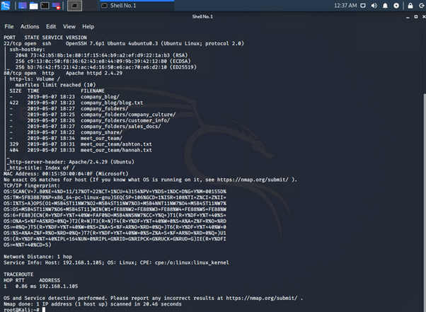
Nmap Scan: Port 22 & 80 Open
Nmap Service and Version Scan:

Slide 18
Sensitive Data Exposure Exposure of Sensitive Information to an Unauthorised Actor
Tools
Processes
Achievements
Manual Access
We access the insecure Apache HTTP website 192.168.1.105
Navigating through the directories we find information relating to the company_secret_folder

Slide 19
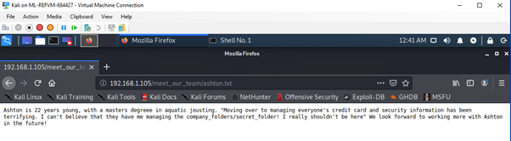
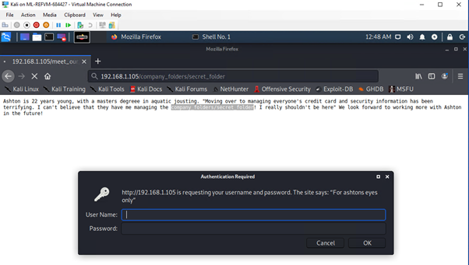
Company Folder
Secret Folder

Slide 20
Brute Force Attack Inadequate Encryption Strength
Tools
Processes
Achievements
Hydra
We use the information found in the company_secret_folder and run a brute-force attack on the password protected secret folder command: hydra -l ashton -P /usr/share/wordlists/rockyou.txt -s 80 -f -vV 192.168.1.105 http-get /company_folders/secret_folder
Successful retrieval of User and Password

Slide 21
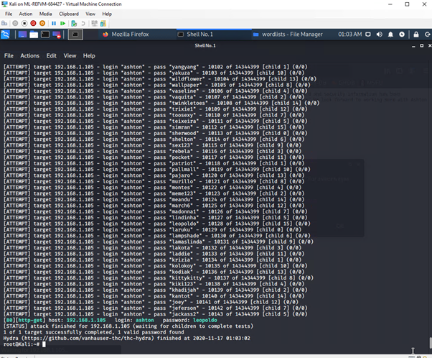
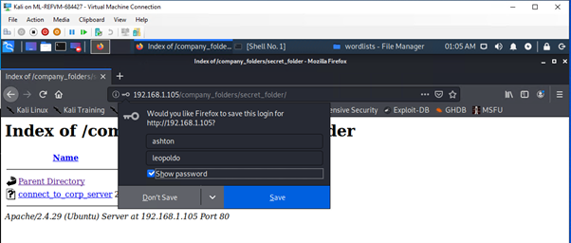
Hydra
Login with user Ashtons credentials

Slide 22
Unlock Folder to Compromise Server Insecure Storage of Sensitive Information
Tools
Processes
Achievements
Manual access via folder
Access password protected folder with credentials of obtained, Analyse contents folder
Uncover instructions to access the WebDav Corporate Server and user Ryans Hash

Slide 23
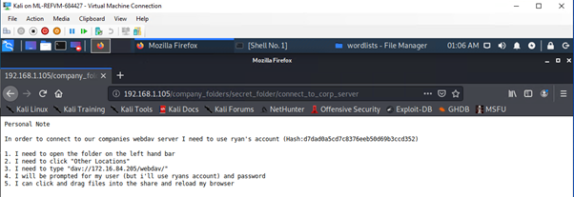
Company Folder Secret Folder, Instructions to connect to Corporate Server

Slide 24
Password Crack Weak Encoding for Password
Tools
Processes
Achievements
CrackStation
Copy retrieved hash into CrackStation
Successfully obtained user Ryans Hash to login into Corporate Server

Slide 25
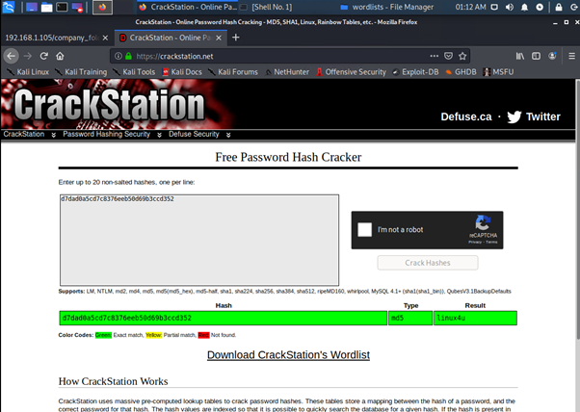
Crack HASH with CrackStation

Slide 26
Upload PHP to WebDav Unrestricted Upload of File
Tools
Processes
Achievements
Cadaver
We use cavader the CLI for webdav to login
Successful login with user Ryans credentials
Login to WebDav

Slide 27
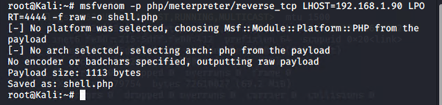
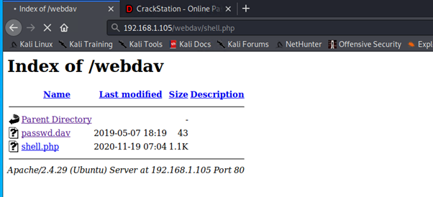
Locate and customize the reverse shell script to upload
Reverse Shell Script uploaded

Slide 28
Remote Code Execution Unrestricted Upload of File
Tools
Processes
Achievements
Msfvenom
Cadaver
Metasploit
Command line
Command line instance of Metasploit we use to generate and output the shell code
Use Cadaver to upload PHP shell code onto our target
Start listener and deliver payload
Command: find . -iname flag.txt
Locate and customize the reverse shell script to upload
Success Shell.PHP on target
Performed successful reverse attack and gained shell and root access
Search and retrieve the Flag

Slide 29
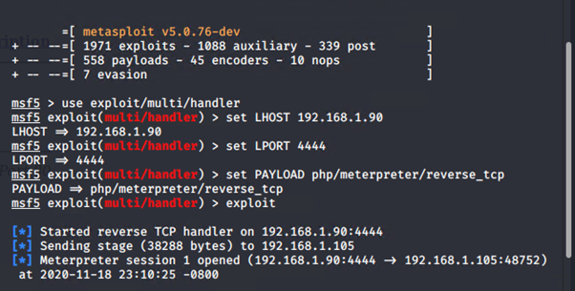
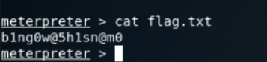
Start Listener, Deliver Payload, Gain Shell
Search and Retrieve Flag

Slide 30
Blue Team Log Analysis and Attack Characterisation

Slide 31
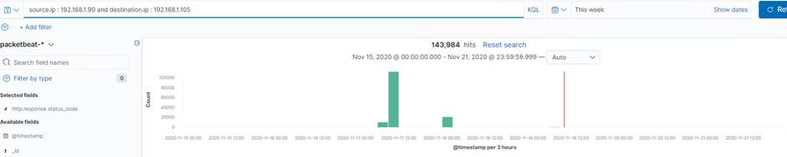
Log Analysis and Attack Characterisation Identifying the Port Scan
Port Scan occurred Nov 15
143,984 Packets sent from the IP address 192.168.1.90

Slide 32
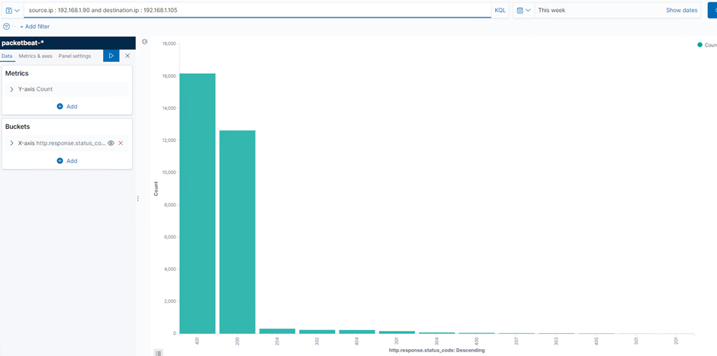
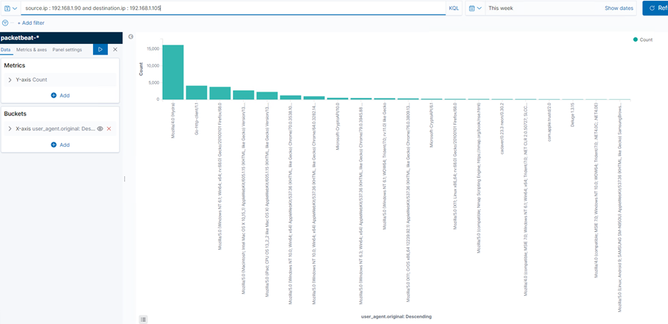
Log Analysis and Attack Characterisation Identifying the Port Scan
401 Victim Responses
NMAP Observed

Slide 33
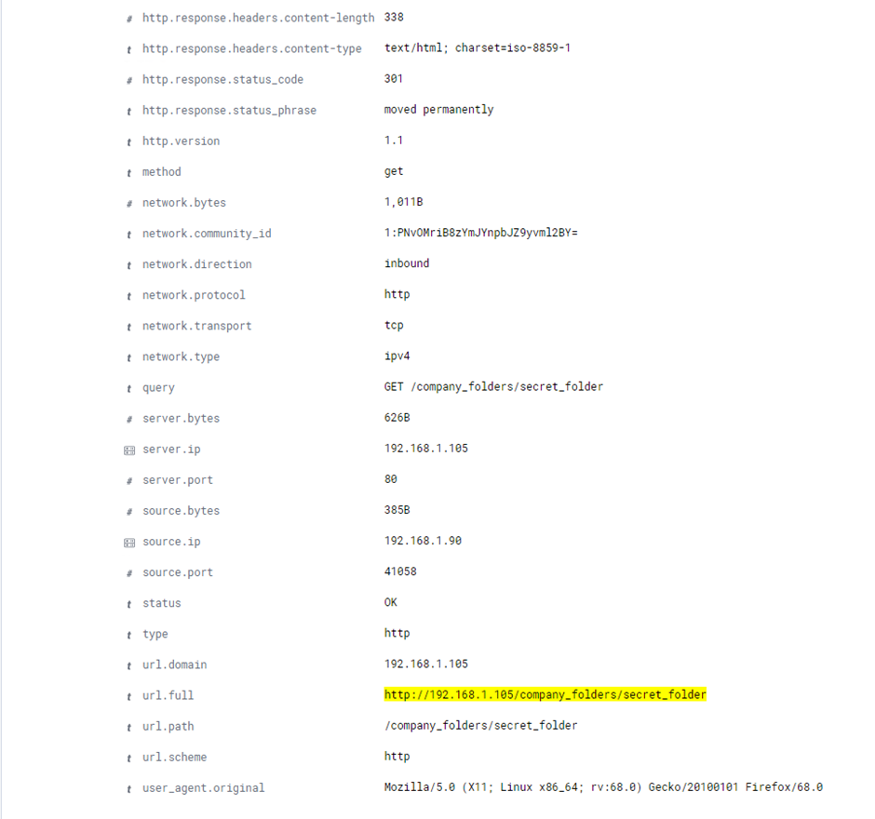
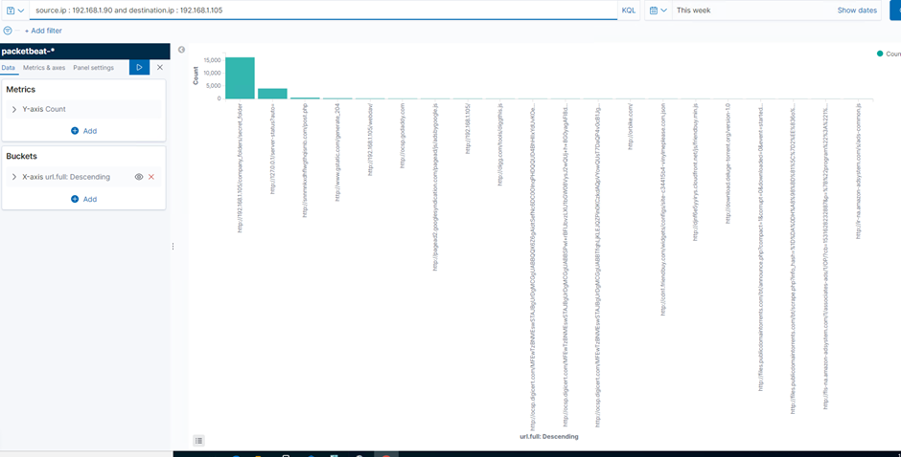
Log Analysis and Attack Characterisation Finding the Request for the Hidden Directory The requests for the Hidden Directory occurred Nov 15, 15 354 requests were made Company Folders Secret Folder was requested

Slide 34
Log Analysis and Attack Characterisation Uncovering the Brute Force Attack 15,451 requests were made in the attack before the password was discovered

Slide 35
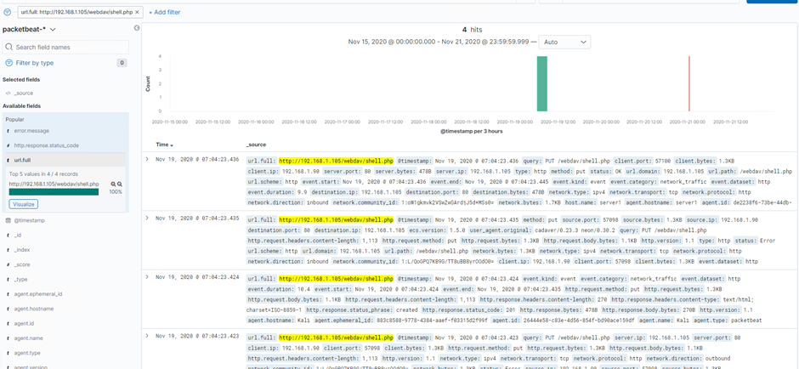
Log Analysis and Attack Characterisation Identify WebDav Connection and Reverse Shell We see the WebDav connection and the PUT request to upload the payload to target

Slide 36
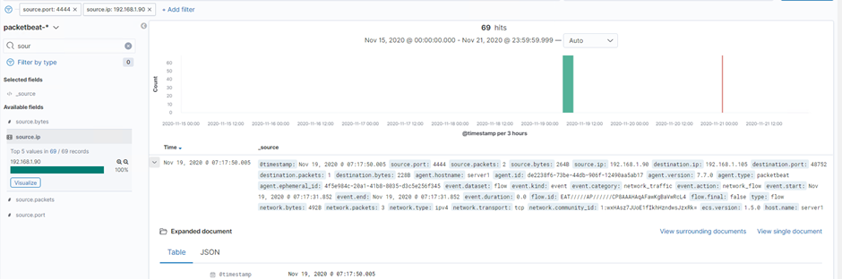
Log Analysis and Attack Characterisation Identify the Reverse Shell and Meterpreter Traffic We filter and analyse Ports and see the reverse shell

Slide 37
Blue Team Proposed Alarms and Mitigation Strategies

Slide 38
Proposed Alarms and Mitigation Strategies Identify Port Scanning
Alarm
System Hardening
Detect NMAP
Filtered Ports
Closed Ports
Firewall Rules to detect / Block
Rate-limiting traffic from a specific IP address would reduce the web server's susceptibility to DoS conditions, as well as provide a hook against which to trigger alerts against suspiciously fast series of requests that may be indicative of scanning.

Slide 39
Proposed Alarms and Mitigation Strategies Finding the Request for the Hidden Directory
Alarm
System Hardening
Monitor and Set Alarm for unauthorised access to hidden directory
Whitelist IP addresses for sensitive folder access
Multi Factor Authentication
Data Encryption

Slide 40
Proposed Alarms and Mitigation Strategies Preventing Brute Force Attacks
Alarm
System Hardening
In this case alert to detect Hydra, however a blanket alert for multiple unsuccessful attempts
Block user agent (Hydra)
Use Certificates
The fail2ban utility can be enabled to protect against brute force attacks

Slide 41
Proposed Alarms and Mitigation Strategies Detecting the WebDav Connection
Alarm
System Hardening
Alert for any IP not whitelisted accessing WebDav
Threshold:
No unauthorised access
Ban PHP extension or any files that contains executable code
File uploads require authentication

Slide 42
Proposed Alarms and Mitigation Strategies Identifying Reverse Shell Uploads
Alarm
System Hardening
Alert for any for any outbound traffic that is not using HTTP or HTTPS protocols
Firewall (Stateful) to track network connections and packets
Command:
Ban PHP extension
Block Ports 4444

Slide 43
The End

